Slide 1

Math's 9
The Final Differentiation

Slide 2
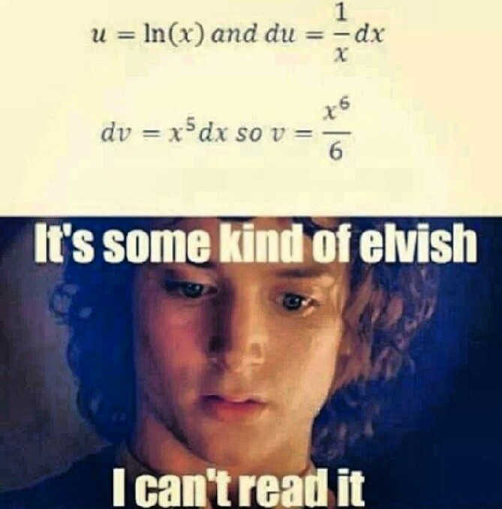
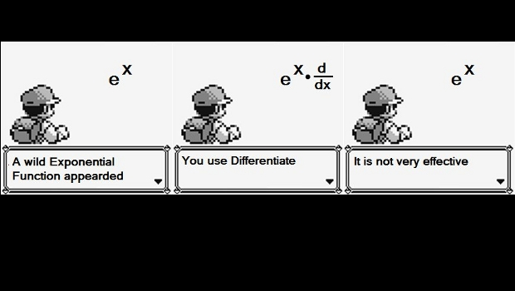
The Final Rules

Slide 3
The Final Rules
As a final round up to differentiation we will cover some of the odder more specific rules.
These are things you just have to remember (lets be honest google it when you need it).

Slide 4
The Final Rules
We’ve been differentiating exponents before where x³ etc.
But if our function is 3^{x} things get a bit trickier.
We first have to understand how the exponential works and its reverse the logarithm.

Slide 5
The Final Rules
We’ve covered exponential functions but not the exponent constant or the reverse exponent – Logarithm.
If we think about an exponent b^{x} we have b the base brought to an exponent x.
The logarithm is the inverse function of this so the inverse of b^{x} is log_{b} b^{x} = x.

Slide 6
The Final Rules
If we have a simple exponent 2³= 8
2 is our base and 3 is our exponent with 8 being the output of the function.
So we can find what the exponent of the function is if it had been 2^{x} = 8 by using the logarithm.

Slide 7
The Final Rules
If we have a simple exponent 2³= 8
2 x 2 = 4

Slide 8
The Final Rules
If we have a simple exponent 2³= 8
4 x 2 = 8

Slide 9
The Final Rules
If we have a simple exponent 2³= 8
4 x 2 = 8
So we have 3 steps to get to the exponent so the exponent is 3.
This is all the log does.

Slide 10
The Final Rules
If it had been 2^{x}= 8
We could have solved for x by just using log₂8 = x

Slide 11
The Final Rules
Exponential and log functions have a wide variety of uses in theoretical and applied sciences.
Describing populations or transforming data.
With the log function the base is important changing the shape.
The most used base is 10 while base 2 is used in programming.

Slide 12
The Final Rules
Derivation of an exponential function is unique since the slope is directly proportionally to the x value of the function.
This means that as x increases, so does the slope.
If we have a function y = b^{x+c}, it is ‘b’, the base, that determines the relationship between slope and value and ‘c’, the constant, that determines the intercept

Slide 13
The Final Rules- e
There is one special case that you need to know, it has to do with the constant e (~2.718) like pi, e is an irrational number
If we have a function y = e^{x} then the slope of the line at any point equals the y value at that point
If the slope of the line at any point is also the derivative, this means that the derivative of y = e^{x} is y = e^{x}.

Slide 14
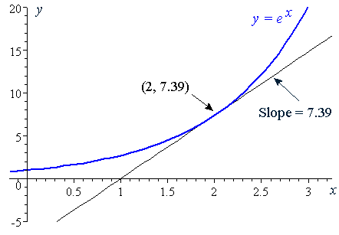
The Final Rules
The important thing to note is that the slope (the derivative) is the same as the y value at every point

Slide 15
The Final Rules
e as a mathematical constant is important as it is a commonly used base of log and is the base of log used in derivation of exponentials.
The log to base e is often just called ln

Slide 16
The Final Rules
So if we want to differentiate a general exponential function we use the formula:
y = b^{x} then y’ = (b^{x}) log_{e}b^{x}

Slide 17
The Final Rules
So if we want to differentiate a general exponential function we use the formula:
y = b^{x} then y’ = (b^{x}) log_{e}b^{x}

Slide 18
The Final Rules
Lets try using it:
y = b^{x} then y’ = (b^{x}) log_{e}b^{x}
y = 2^{x}

Slide 19
The Final Rules
Lets try using it:
y = b^{x} then y’ = (b^{x}) log_{e}b^{x}
y = 2^{x}
y’ = (2^{x}) log_{e}2^{x}

Slide 20

The Final Rules
To derive the log function we use a rule based on the chain rule.
If y = log_{b}(x) then y’ = $\frac{1}{xln({b)}}$

Slide 21
The Final Rules
Finally we can differentiate trigonometric functions like sin cos and tan.
These are just rules that you have to remember the proof’s of which are heinously complicated and involve an understanding of the limits of trigonometric functions.

Slide 22
The Final Rules
The differential of sin(x) = cos(x)
So if we have an angle of 30 and a function of sin(30) then the differential is cos(30)
Sin(30) = 0.5
Cos(30) = 0.866

Slide 23
The Final Rules
The differential of cos(x) is –sin(x)
Again if we return to x = 30 (remember sin is a transformation function not always angles).
Cos(30) = 0.866
-sin(30) = -0.5

Slide 24
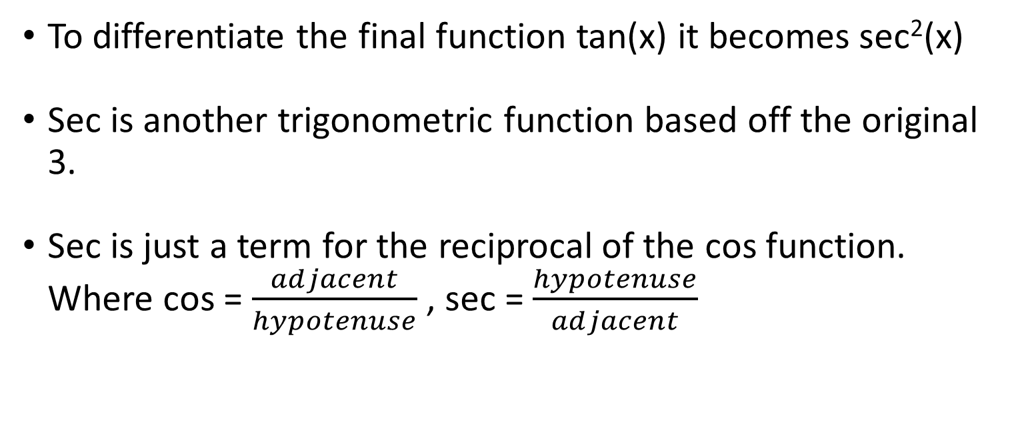
The Final Rules
To differentiate the final function tan(x) it becomes sec²(x)
Sec is another trigonometric function based off the original 3.
Sec is just a term for the reciprocal of the cos function. Where cos = $\frac{adjacent}{hypotenuse}$ , sec = $\frac{hypotenuse}{adjacent}$

Slide 25
The end?
Hopefully that was a quick lecture and we have time to do some recap.

